Slide 1

Robotics
Variable and Datatypes

Slide 2
Variable
A variable is used in programming to store a value that may change during the life of the program/Sketch.
Memory is set aside for storing the variable and the variable is given a name that allows it to be accessed in the sketch.
Declaring Variable :
Datatype variable name;
Eg: int a;

Slide 3
Naming a Variable
Variables can be given any name that you like, so long as it sticks to the rules set out below.
It is best to give variables meaningful names that help you and others to understand the sketch better.
For e.g. score_total would be a good variable name for a variable that is storing the running total of a score in a sports match.

Slide 4
Variable Naming Rules
Variables can consist of any letters (a to z and A to Z).
Variables can contain the numbers 0 to 9, but may not start with a number, e.g. 3var is not allowed, but var3 is allowed.
Variables may not have the same names as Arduino language keywords, e.g. you can not have a variable named int.
Variables must have unique names i.e. you can not have two variables with the same name.
Variable names are case-sensitive, so Count and count are two different variables.
Variables may not contain any special characters, except the underscore (_), e.g. top_score.

Slide 5
Initializing Variables
A variable can also be assigned an initial value when it is defined as shown below:
int total = 0;

Slide 6
Data Types
Data types in C refer to an extensive system used for declaring variables or functions of different types.
The type of a variable determines how much space it occupies in the storage and how the bit pattern stored is interpreted.

Slide 7
Data Types
The following table provides all the data types that you will use during Arduino programming.
Void | char | Unsigned char
Boolean | Byte | Word
Int | String-char array | Unsigned int
float | long | double
Unsigned long | array | short

Slide 8
Integer (int) :
Integers are the primary data type for number storage. Int stores a 16-bit (2-byte) value. This yields a range of -32,768 to 32,767. Unsigned int(s) (unsigned integers) are the same as an int in the way that they store a 2-byte value.
Instead of storing negative numbers, however, they only store positive values, yielding a useful range of 0 to 65,535.
Declaration → int i;
Initialization → int i=10;

Slide 9
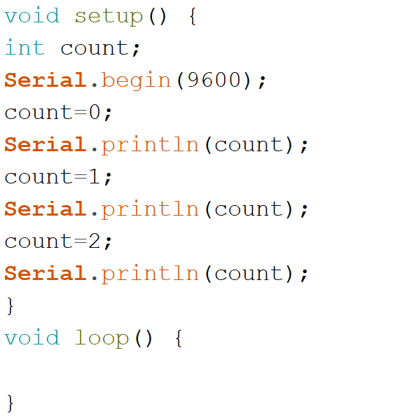
Code for int data type

Slide 10
float :
Data type for floating-point number is a number that has a decimal point. Floating-point numbers are often used to approximate analog and continuous values because they have greater resolution than integers.
Floating-point numbers can be as large as 3.4028235E+38 and as low as -3.4028235E+38. They are stored as 32 bits (4 bytes) of information.
Example → float num = 1.352;

Slide 11
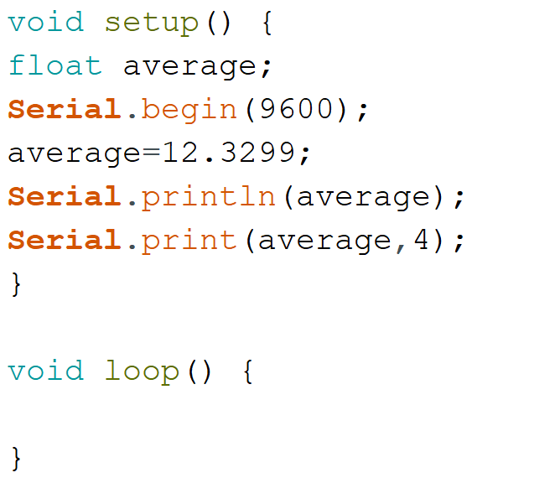
Code for float data type

Slide 12
Long :
Long variables are extended size variables for number storage, and store 32 bits (4 bytes), from -2,147,483,648 to 2,147,483,647.
Example → Long velocity = 102346;

Slide 13
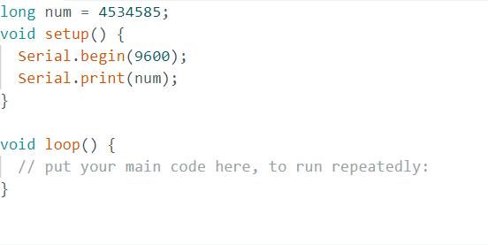
Code for Long data type

Slide 14
Char :
A data type that takes up 1 byte of memory that stores a character value. Character literals are written in single quotes, like this: 'A' (for multiple characters - strings - use double quotes: "ABC").
Characters are stored as numbers, however. You can see the specific encoding in the ASCII chart. This means that it is possible to do arithmetic on characters, in which the ASCII value of the character is used (e.g. 'A' + 1 has the value 66 since the ASCII value of the capital letter A is 65).
Example → char myChar = 'A’;
char myChar = 65; // both are equivalent.

Slide 15
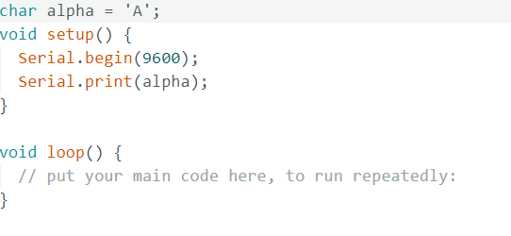
Code for char data type

Slide 16
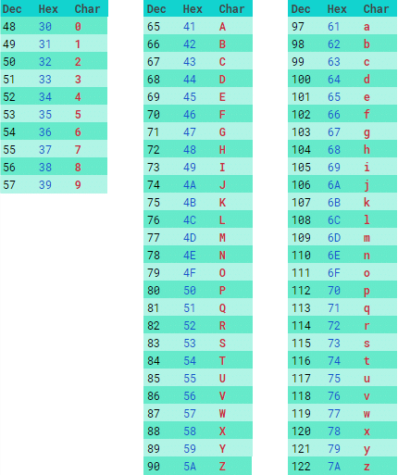
ASCII table for Alphabet

